Slide 1

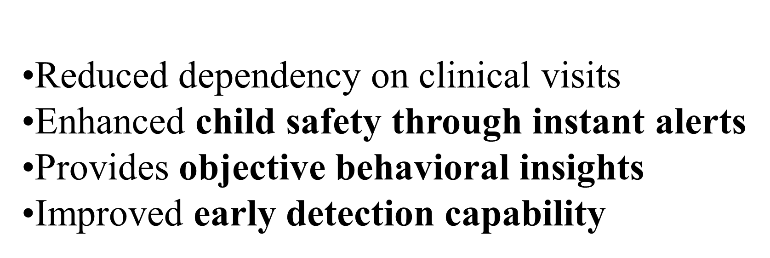
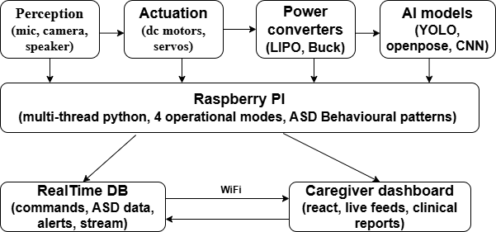
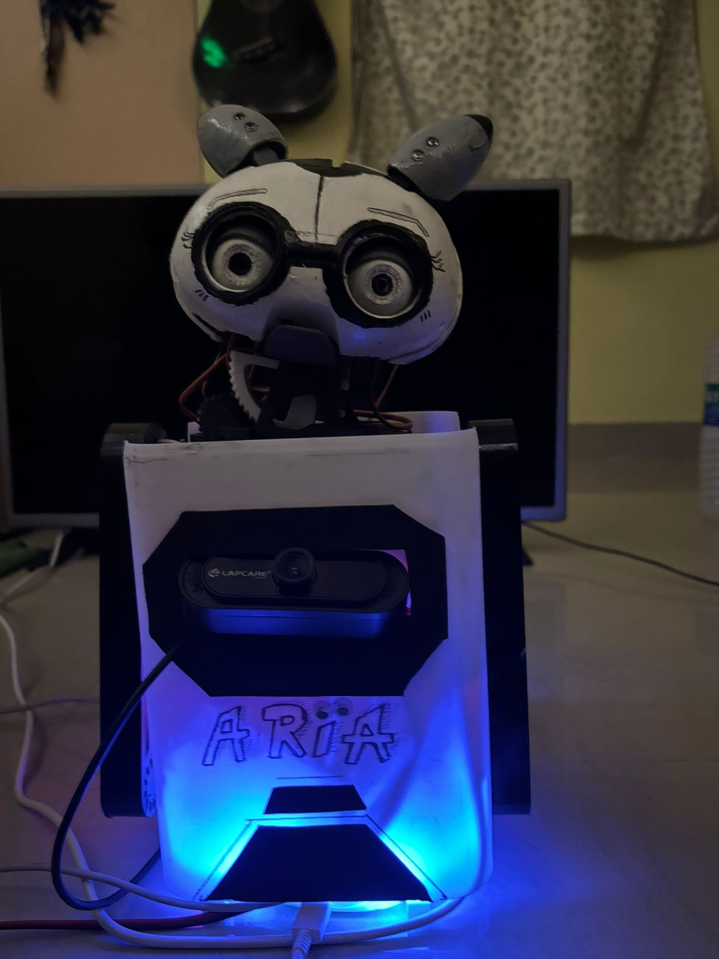
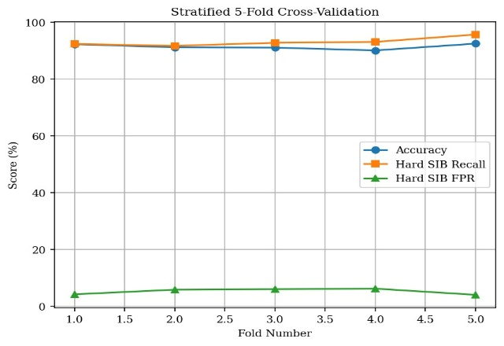
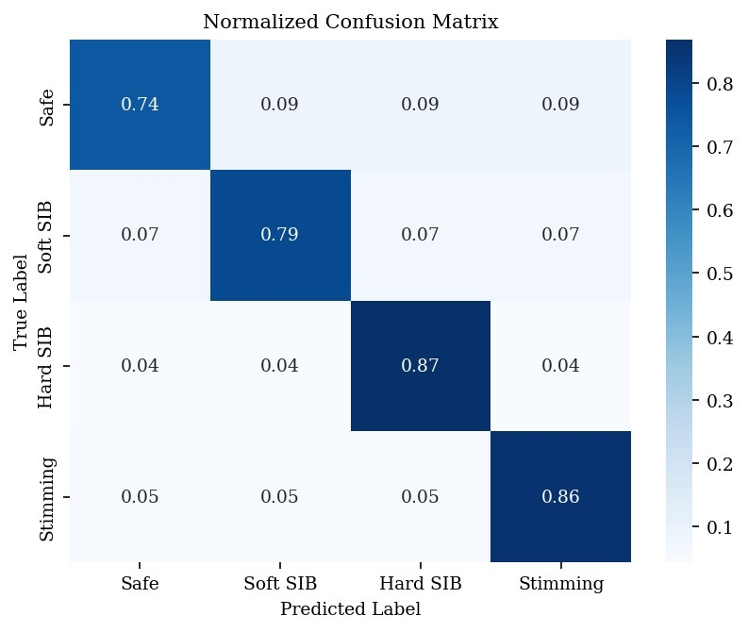
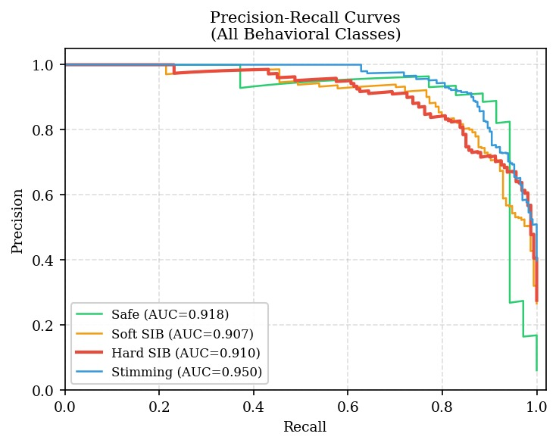
An open AI powered agent for Human Robot Interaction
Siddarth Vinnakota(RA2211004010396), Made Karthikeya(RA2211004010400), Krittika Roy(RA2211004010450)
Dr. R Srinath Assistant Professor
21ECP401L-Major Project
Department of Electronics and Communication Engineering, SRM Institute of Science and Technology, Kattankulathur
INTRODUCTION/ABSTRACT
METHODOLOGY/BLOCK DIAGRAM
RESULTS & INFERENCE
Autism Spectrum Disorder (ASD) affects 1 in 31 children in the U.S. (CDC, 2024). Diagnosis is slow, subjective, and clinic-dependent — leaving children without timely intervention. The proposed system is an AI-powered robotic companion designed for home use, providing continuous behavioral monitoring, real-time self-harm detection, and interactive learning — replacing episodic clinical observation with 24/7 intelligent support.
The algorithm achieves high performance with an overall accuracy of 91.5%, along with 93.1% recall in detecting self-injurious behavior and 85.7% accuracy in identifying repetitive actions (stimming).
Metric | Test Set | CV Mean & STD
Overall accuracy | 91.5% | 91.5% ± 0.8%
Hard SIB recall | 93.1% | 93.1% ± 1.2%
Hard SIB precision | 72.8% | 72.8% ± 1.5%
Hard SIB F1-Score | 78.9% | 78.9% ± 1.3%
Hard SIB Support | 5.2% | 5.2% ± 0.4%
Soft SIB Recall | 79.2% | 78.8% ± 1.4%
Stimming Recall | 85.7% | 85.3% ± 1.1%
CONCLUSION
The proposed system provides a smart, real-time, and non-invasive solution for monitoring children with ASD. By combining AI, robotics, and cloud technologies, it ensures safety, continuous observation, and improved diagnosis support.
Fig 1 Block Diagram
REFERENCES
DESIGN
[1] Ben-Sasson, A., Guedalia, J., Nativ, L., Ilan, K., Shaham, M., and Gabis, L. V., "A Prediction Model of Autism Spectrum Diagnosis from Well-Baby Electronic Data Using Machine Learning," Children, 11(4), p. 429, 2024.
[2] Negin, F., Ozyer, B., Agahian, S., Kacdioglu, S., and Tumuklu Ozyer, G. T., "Vision-Assisted Recognition of Stereotype Behaviours for Early Diagnosis of Autism Spectrum Disorders," Neurocomputing, 446, pp. 145–155, 2021.
MOTIVATION
Dataset: Public ASD behavioral datasets
Image processing: Resizing, normalization, augmentation
Models used:
YOLOv8 (Real-time detection), OpenPose (Pose estimation)
Hardware:
Raspberry Pi 5, Camera & microphone, Motors & servo controllers
Software:
Python (multi-threading), Firebase (cloud storage), React Dashboard
Dependence on clinical environments and experts
Manual observation leads to inconsistent results
High cost and limited accessibility in rural areas
Lack of real-time safety monitoring
No continuous behavioral tracking in natural environments
Fig 2 Hardware implementation of the robot
Fig 3 5 Fold cross validation
SUSTAINABLE DEVELOPMENT GOALS
PROBLEM STATEMENT/OBJECTIVE
SDG 3- Good Health & Well-Being
SDG 9- Industry, Innovation & Infrastructure
To ensure child safety through real-time monitoring.
To enable early detection and improve intervention outcomes.
To provide continuous home-based observation instead of hospital visits.
To reduce caregiver burden using automated assistance.
To enable an affordable and scalable ASD support system.
REALISTIC CONSTRAINTS
Fig 4 –confusion matrix
Accuracy depends on dataset quality
Camera-based system may face lighting issues
Hardware limitations affect real-time speed
Requires high computational power
CONFERENCE /JOURNAL PUBLICATION
ENGINEERING STANDARDS
The research work titled "Two stage hybrid flow classifier for real time self-injurious behaviour surveillance in children with ASD" has been presented at the 4th international conference in AI and ML applications (AIML 2026).
DICOM – Medical data handling
ISO/IEEE standards for system interoperability
IEC 62304 – Medical software lifecycle
Fig 5- Precision-recall curves

